Slide 1
Unit 6: Object Oriented Analysis and Design

Slide 2
Object Oriented Analysis and Design
The term object oriented describes the system as a collection of discrete objects that incorporate both data structure and behavior.
It is a way of thinking about problems and solutions using real world concepts.
Object oriented analysis and design promote the better understanding of requirements, cleaner design and more maintainable system.

Slide 3
2 part
Object-oriented analysis
Object- oriented design
Object-oriented analysis is a method of analysis that examines requirements from the perspective of the classes and objects found in the vocabulary of the problem domain.
Object- oriented design is a method of design for depicting logical and physical as well as static and dynamic models of the system under design.

Slide 4
Object Oriented Development Life Cycle
takes the objects as the basis.
first the system to be developed is observed and analyzed and the requirements are defined
Once this is done, the objects in the required system are identified.
Eg, in Banking System, a customer is an object, a chequebook is an object, and even an account is an object.

Slide 5
Object oriented development life cycle contains:
System Analysis
first phase of development in case of Object Modeling too.
developer interacts with the user of the system to find out the user requirements
and analyses the system to understand the functioning.
Based on this system study, analyst prepares a model of the desired system to analyze and depict these objects.
This model is purely based on what the system is required to do.
based on the idea that the system is made up of a set of interacting objects.

Slide 6
The methodology supports and uses three basic Models:
Object Model
describes the objects in a system and their interrelationships.
observes all the objects as static and does not pay any attention to their dynamic nature.
b. Dynamic Model:
depicts the dynamic aspects of the system.
It portrays the changes occurring in the states of various objects with the events that might occur in the system.
c. Functional Model:
describes the data transformations of the system.
describes the flow of data and the changes that occur to the data throughout the system.

Slide 7
2. System Design
next development stage where the overall architecture of the desired system is decided.
The system is organized as a set of sub systems interacting with each other.
analyst takes care of specifications as observed in system analysis as well as what is required out of the new system by the end user.
3. Object Design
details of the system analysis and system design are implemented.
Objects identified in the system design phase are designed.
objects are created using data structures
eg, we can define a data type called pen and then create and use several objects of this data type like (ink pen, gel pen)

Slide 8
4. Implementation
objects and their interrelationships translated/coded using the programming language
The databases are made and the complete system is given a functional shape.

Slide 9
Basic Characteristics Of Object Oriented System
Class:
Object- real life entity
Class- entity type
Is Objects with same data structure and behavior grouped in to a class.
i.e. collection of similar objects
class defines the basic attributes and the operations of the objects of that type
i.e. is a template where certain basic characteristics of a set of objects are defined
Defining a class does not define any object, but it only creates a template
For objects to be actually created instances of the class are created as per the requirement of the case.

Slide 10
Class- Human Object-Man Woman
C- fruit O- apple, mango
C- phone O- Samsung, iphone
Student
Name Dob address
Cal_age() Cal_gpa() Register_for_course()
class name
List of attributes
List of operations
Dog
Breed Size Color
Eat() Sleep() Sit()

Slide 11
2. Abstraction
Classes are built on the basis of abstraction
Hides unnecessary information and only shows necessary information
Eg, chair
purpose is to sit, shows color, 4 leged or 6 leged
hides information like how it is made-manufacturing firm, which nails are used which brand color is used.
3. Inheritance:
sharing of attributes and operations among classes based on hierarchical relationship.
A super class has general information that subclasses refine and elaborate.
Each sub class inherits all the feature of its super class and adds its own unique features.
This concept is used to apply the idea of reusability of the objects.

Slide 12
4. Polymorphism
means the same operation may behave differently for different classes.
Eg, communicate
Human- communicate via talking
Dog- communicate via barking
5. Reusability:
The classes once defined can easily be used by other applications.
This is achieved by defining classes and putting them into a library of classes where all the classes are maintained for future use.
Whenever a new class is needed the programmer looks into the library of classes and if it is available, it can be picked up directly from

Slide 13
6. Encapsulation
Is a process of wrapping data and function into a single unit called class
Helps preventing modification of data from outside the class by assigning privileges to data inside the class
i.e. data access to those function which are wrapped in class

Slide 14
UML Diagram
Unified Modelling Language
A general purpose developmental, modeling language in the field of software engineering
that is intended to provide a standard way to visualize the design of a system.
It’s not a programming language
it’s a set of rules specifically for drawing diagrams.
Visually represent the architecture, design, and implementation of software systems.
Instead of thinking them as just a “nice to have,”
treat your UML diagrams as core aspects of documentation.
they keep development productive and focused.
Help s/w developers for specifying, visualizing constructing and documenting artifacts of system

Slide 15
UML includes many diagrams that represent different perspectives of a system.
Structure Diagrams
represent the static application structure
Static aspect represent the part of a diagram that form main structure and are stable
Assist in understanding and communicating with elements that make up a system and the function it provides
Types
Class Diagram
Object Diagram
2. Behavior Diagrams
represent dynamic/different aspect of system
dynamic aspect represent the changing/moving part of the system
Assist in understanding and communicating how elements interact and collaborate to provide functionality of the system
Types
Use Case Diagram
Sequence Diagram
Activity Diagram
State Diagram

Slide 16
Class Diagram
Object Diagram
defines the basic attributes and the operations of the objects of that type
Consists of classes, internal structure and their relationship in which they participate to depict a system’s structure.
(classes, interfaces, association and collaboration)
They provide an overview of the project as seen as a collection of static elements.
Describe responsibilities of a system
Represented by rectangle with 3 compartments, separated by horizontal lines
Class name
List of attributes
List of operation
Represents set of object and their relationship
Represents instance of class diagram
Shows static snapshot of element instance found in class diagram
Represented by rectangle with 3 compartments, separated by horizontal lines
Object name
List of attributes
Object- real life entity – ram, ktm, student
Class- entity type (collection of entities with similar attributes)- student, course, vendor
Attributes- properties – id, name, roll

Slide 17
Fig: Class diagram showing 2 classes
Student
Name Dob address
Cal_age() Cal_gpa() Register_for_course()
class name
List of attributes
List of operations
Course
C_code C_title Credit_hours
enrollement()
Fig: Object diagram showing 2 instances
Mary Jones: Student
Name: Mary Dob: 1980-1-1 Address: US
SE: Course
C_code: CACS253 C_title: SE Credit_hours:3
object name= class name
17

Slide 18
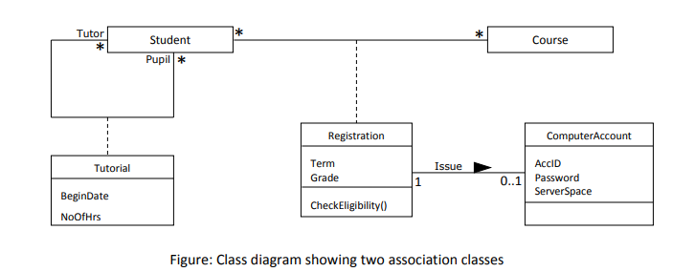
1:1 association
Or 1:N
Or N:N

Slide 19
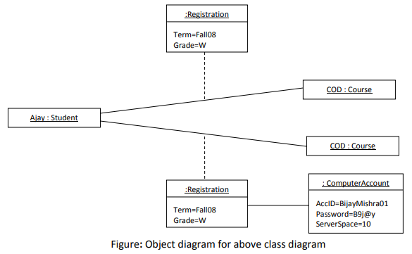

Slide 20
Relationships within the class diagram
Association
describes the communication between two classes.
1:1 relationship
1:M
M:N
1
manages
1
Employee
Store
Painter
1
manages
M
Store
M
manages
N
Employee
Store

Slide 21
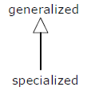
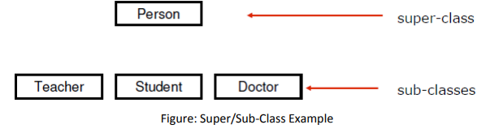
2. Generalization
is a direct relationship between a general class (superclass/parent) and a special class (subclass/child)
it enables inheritance. It is not an association.
Specialization is the process of creating more specialized subclasses from an existing class

Slide 22
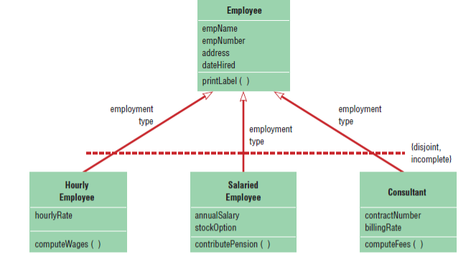

Slide 23
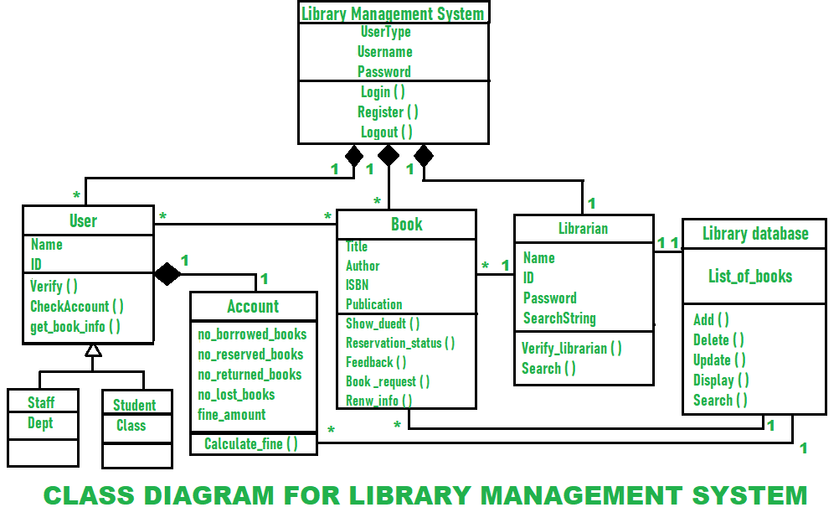

Slide 24
Use Case Diagram
Use case diagrams are set of use cases, actors and their relationship.
in simple terms, they represent functionality a system.
depict how users interact with a system through use cases that produce observable results.
model how users, displayed as stick figures called “actors,” interact with the system.
This type of UML diagram should be a high-level overview of the relationships between actors and systems,
so it can be a great tool for explaining your system to a non-technical audience.

Slide 25

1.System
Whatever you are developing (website, app, software component, etc)
2.Actors
Is someone or something that uses the system to achieve a goal. (person, organization, another system, etc)
3.Use Cases
Describes what our system does
Represents an action that accomplishes some task within the system.
Should be in logical order as far as possible
Primary Actors | Secondary Actors
Who initiates the use of the system | Who reacts (reactionary users)
Should be in the left of the system | Should be in the right of the system

Slide 26


4.Relationship
Represents which uses cases are associated with actors
Association, include, exclude
Association
Solid line
Include
Shows relationship between base use case and included use case
When ever base use case is executed, included use case is executed as well
Requires included use case in order for base use case to be complete
Dashed line with arrow pointed towards included use case
Exclude
Similar like include but excluded use cases happens sometimes only not every time
Only executed if certain criteria are met
Extends the behavior of the base use case by adding a new behaviour or action
Dashed line with arrow pointed towards base use case

Slide 27
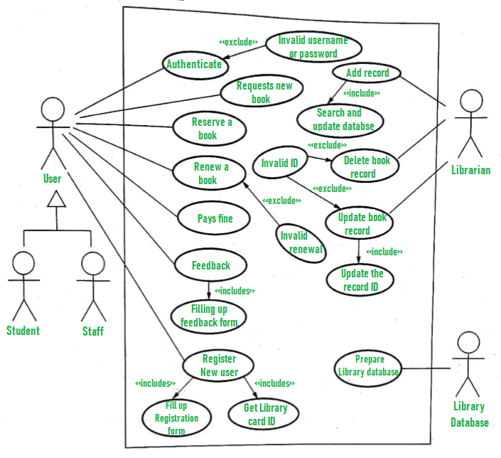

Slide 28

Sequence Diagram
Shows interactions between objects during a certain period of time in sequential order
arranged in time sequence – by message exchange with one another
Describe how and in what order the objects in a system function
Elements
1.Class/Objects:
denoted by rectangle with the name inside.
Classes that send or receive messages are shown at the top of the sequence diagram.
2. Lifeline:
Vertical dashed line
represents the object’s existence over a certain period of time.
represents the time during which the object above it is able to interact with the other objects
Class/Object

Slide 29

3.Activation/Focus:
A narrow vertical shape that covers the lifeline.
thin rectangle superimposed on the lifeline of an object represents an activation of the object
indicates when an object sends or receives a message.
shows the period during which the object performs an operation
4. Messages:
represented by a line showing direction that runs between two objects.
Objects communicate with one another by passing messages.
The label shows the name of the message and can include additional information about the contents.

Slide 30
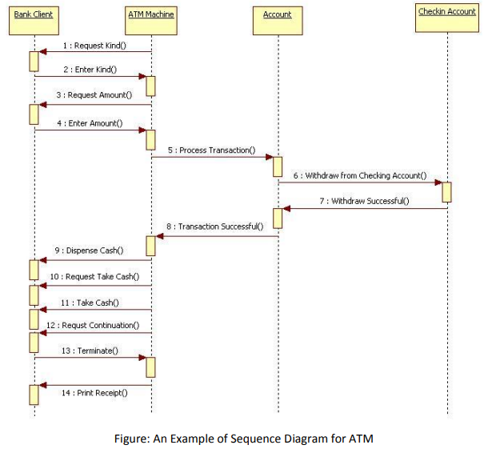

Slide 31
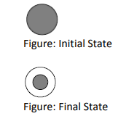
State Diagram
Also known as event model diagram
Represent events that are responsible for state change of the system during its lifetime
Represent behaviour of system using finite state transition
Elements
State
Shown as a rectangle with rounded corners
A condition/situation during the life of an object during which it satisfies some conditions, performs some actions/activity or waits for some events

Slide 32

2. State Transition
changes in the attribute of an object or in the links an object has with other objects
Shown as a solid arrow
3. Event
Is something that takes place at a certain point in time
Events trigger state transitions

Slide 33
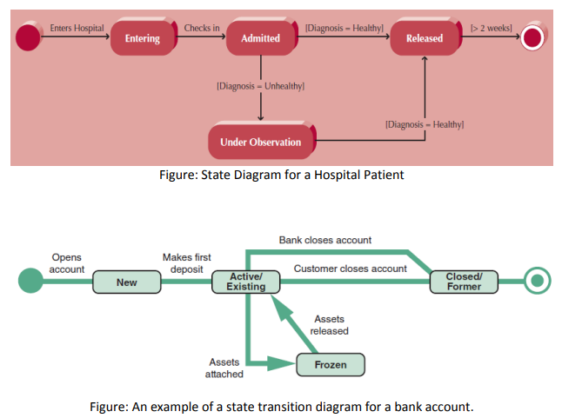

Slide 34
Activity Diagram
A type of state diagram
Describes flow of system
Shows how activities are performed with system flow
Describes sequence from one activity to another

Slide 35
